Slide 1
Supply Chain Transfers Direct Ship, Internal, and Back-to-Back Orders
Session ID#: 10366
Prepared by:
Ed McDonough
Director, Solution Delivery
Avout
#Avoutcorp

Slide 2
Presenter Background
Ed McDonough
Director, Solution Delivery
Avout Corporation
20+ Years Implementing Oracle Solutions
15 Years’ Experience in Distribution & Manufacturing
Project Methodology and Re-Engineering Designer
Oracle Community Education & Development Contributor
Oracle Accelerator

Slide 3
Agenda
Why have transfers?
Direct Orders - Functionality
Direct Orders – Flow
Direct Orders - Setups
Internal Orders - Functionality
Internal Orders - Flow
Internal Orders - Setups
Back-to-Back Orders - Functionality
Back to Back Orders - Flow
Back to Back Orders - Setups
Summary
Questions

Slide 4
Why Have Transfers?
Visibility within organization
Customer service to check order status
Purchasing wants to know what supplier fulfilled
Supply Chain Integration
Your supply is my demand
Common view of supply chain
Accounting Connection
Accounting creates appropriate entries
Balances reflect real-time status
Period-end reconciliation
Notes:
Survey audience to see composition IT, Finance, EBS or not, etc. Remember iPhone example throughout.

Slide 5
Direct Orders Functionality
What it does
Direct Order = Drop Shipment
Customer orders a product
Supplier is notified
One step receipt, shipment
Benefits
Supplier notification
Reduced inventory
Improved customer service
Expand overall product offering
Automated transaction processing
Notes:
Use the example of iphone on “what it does”

Slide 6
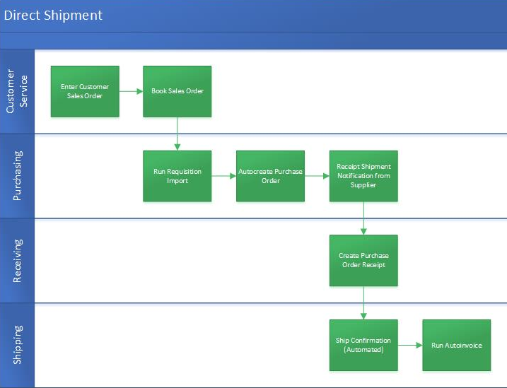

Slide 7
Direct Orders - Setups
Item Attributes - Enabled
Purchased, Purchasable,
Transactable, Stockable
Reservable, Customer Ordered, Customer Ordered Enabled
Shippable, Transactable
Cost Enabled, Inventory Asset Value
Order Line Attribute Source Type
Set to EXTERNAL

Slide 8
Direct Orders - Setups
Optional Setups
Drop Shipment Organization
Default Receiving Subinventory
Default Item Source Type
Automatic Sourcing
Advanced Shipping Notice (ASN)
Pay on Receipt
ATO, PTO models
Across Ledger, Operating Unit

Slide 9
Internal Orders - Functionality
What it does
Inventory Organization 1 requests product
Inventory Organization 2 fulfills request
Inventory Organization 1 receives product
Benefits
Integrated within one Oracle instance
Planning and scheduling visibility
Sourcing flexibility
Fulfillment logistics efficiency
Automated transaction processing
Accounting visibility
Notes:
Use the example of iphone to explain “what it does”

Slide 11
Internal Orders - Setups
Item Attributes - Enabled
Purchased, Purchasable
Transactable, Stockable
Reservable, Customer Ordered, Customer Ordered Enabled
Internal Ordered, Internal Ordered Enabled
Shippable, Transactable
Cost Enabled, Inventory Asset Value
Inventory
Inter-Organization Shipping Network
Item sourcing, HR Locations
Purchasing
Internal requisitions document type, Purchasing Options

Slide 12
Internal Orders - Setups
Order Management
Internal order source, transaction type
Internal customer with ORG reference in SHIP TO
Internal Price List
Pick & Pack rules as needed for Order Type
Optional Setups
Automatic Sourcing
Cross Operating Unit
Subinventory transfers
Internal orders processing constraints
Direct versus Intransit
Internal order required, Transfer Costs

Slide 13
Back-to-Back - Functional
What it does
Customer orders a product
Supplier is notified
Purchase order line is “linked” for SO line
Benefits
Reduced inventory
Special orders fulfilled for customers
Shipped and handled internally
Preserve “private labeling”
Consolidated shipping
Improved customer service
Notes:
Use the example of iphone and accessories for “what it does”

Slide 14
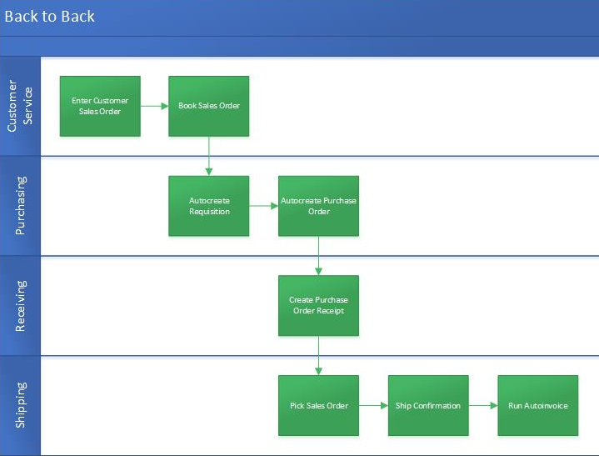
Back to Back - Functional
What it does
Customer orders a product
Supplier is notified
Purchase order line is “linked” for SO line
Benefits
Reduced inventory
Special orders fulfilled for customers
Shipped and handled internally
Preserve “private labeling”
Consolidated shipping
Improved customer service

Slide 15
Back-to-Back Setups
Item Attributes - Enabled
Purchased, Purchasable
Transactable, Stockable
Reservable, Customer Ordered, Customer Ordered Enabled
Assemble to Order, Build in WIP
General Planning - BUY
Shippable, Transactable
Cost Enabled, Inventory Asset Value
Sourcing
Rule or item setup

Slide 16
Summary
Summary of Transfer Types
Direct Orders – Supplier direct to Customer
Internal Orders – Inventory ORG to Inventory ORG
Back-to-Back – Dedicated SO line to PO line
Supply Chain Transfer Benefits
Supply Chain Visibility
Integrated Accounting
Improved Customer Service

Slide 17
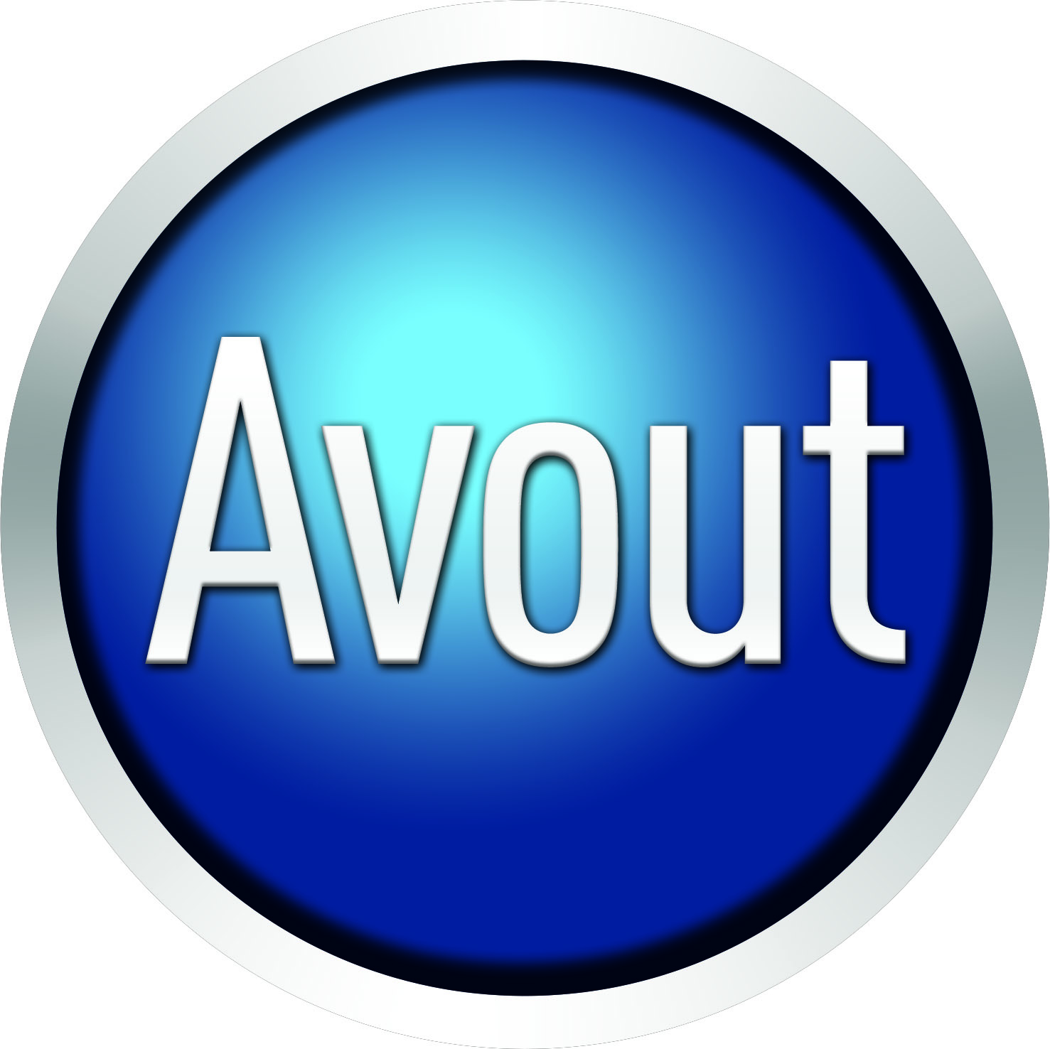
About Avout
Avout is structured to quickly source exactly what an organization needs—no more, no less—via its vast network built over 25 years in the technology space. Avout’s principals and recruiters have run Oracle business units for companies like Oracle, Accenture, and Capgemini, and have sold and delivered hundreds of millions of dollars of Oracle services.
Recently, we joined forces with Pacific Crest Technology® to meet the broader needs of our clients. Our Oracle expertise is now supplemented with a global project management office skilled in solution delivery, and CIO-level strategic advisement in high-growth industry verticals.

Slide 18
Thank You for Attending Please complete the session evaluation We appreciate your feedback and insight
You may complete the session evaluation either on paper or online via the mobile app

