Slide 1
Purchasing Approvals Functionality and Best Practice
Session ID#: 10367
Prepared by:
Ed McDonough
Director, Solution Delivery
Avout
#Avoutcorp

Slide 2
Presenter Background
Ed McDonough
Director, Solution Delivery
Avout Corporation
20+ Years Implementing Oracle Solutions
15 Years’ Experience in Distribution & Manufacturing
Project Methodology and Re-Engineering Designer
Oracle Community Education & Development Contributor
Oracle Accelerator

Slide 3
Agenda
Scope and Approach
Purchasing Definitions
Document Types
Best practice
Direct versus Indirect
Best Practice
Approval Setup Options
Best practice
Wrap Up
Questions

Slide 4
Scope and Approach
Business Process Orientation
10,000 foot level
Oracle Functional
No technical content
Key Areas
Best Practice based on experience
Interactive Discussion
Ask questions as we go

Slide 5
Purchasing Definitions
Document Types
Purchasing documents in Oracle
Direct and Indirect Purchases
Inventory and expense related purchases
AME
Approval Management Engine – HR module
Approval Hierarchy
ORG structure to identify approvals

Slide 6
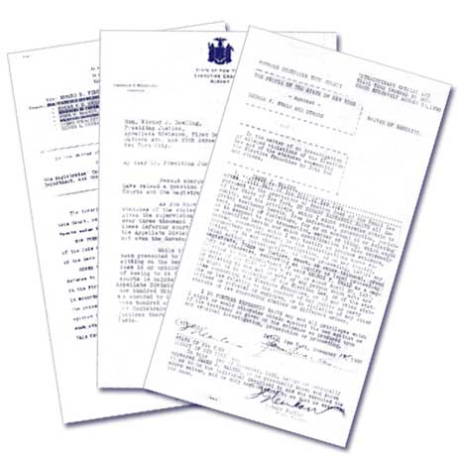
Oracle PO Document Types
Standard PO
Quotation
RFQ (Request for Quote)
Blanket Purchase Agreement
Blanket Release
Requisitions
Internal
Purchase

Slide 7
Purpose of Documents
Requisition
Authorization to give to Buyer
Includes estimates, suggested supplier
Purchase Order
Legal contract on what and how much
Should we approve both Documents?
Requisitions flow into Purchase Orders

Slide 8
Approving the Approval
Requests are Orders
Buyers simply execute
Negotiate favorable terms & pricing
Departments Get Charged
Accounts are generated using various tools
Department resources are requesters

Slide 9
Best Practice – Document Types
Don’t Approve a Document Twice
Requisition approval will suffice
Buyer has assumed authority
Put Controls Where They are Needed
Total expenditures for Department
Expense Type Limits
Other Expense measurements
Project/Task

Slide 10
Direct versus Indirect
Direct Purchases
Inventory
Must have to facilitate Manufacturing & Distribution operations
Indirect Purchases
Expenses
Oriented toward departments
Breakdown of details important
Project/Task/Cost Center/Type/Recurring

Slide 11
Best Practice - Direct versus Indirect
Direct Requisitions should be Auto-approved
Requisitions are necessary in Oracle
No value to controlling
Set realistic PO limits for Buyers based on seniority
Indirect Requisitions require Firm Control
Include full approval cycle
Control areas of concern
Free up Indirect PO approvals

Slide 12
Approval Setup Options
Employee/Supervisor
Most basic setup
Each employee has 1 supervisor only
Skipping levels possible
Approval Hierarchy
Employee can have multiple approval structures
Flexibility to change based on ORG changes
Restricted by ORG approval structure
Approval Management Engine (AME)
Approvals on the fly
Flexible configurations
Parallel approvals possible

Slide 13
Best Practice - Setup Options
Complexity Justifies Outcome
Big spend departments have a lot to lose
Focus on budget areas
Umbrella to measure success
Make Sure People Care
The approval structure needs buy in
Executives are sometimes too busy
Delegate & automate drag

Slide 14
Wrap Up
Don’t approve a document twice
Put controls where they are needed
Direct requisitions should be auto-approved
Indirect requisitions require firm control
Complexity justifies outcome
Make sure people care

Slide 15
About Avout
Avout is structured to quickly source exactly what an organization needs—no more, no less—via its vast network built over 25 years in the technology space. Avout’s principals and recruiters have run Oracle business units for companies like Oracle, Accenture, and Capgemini, and have sold and delivered hundreds of millions of dollars of Oracle services.
Recently, we joined forces with Pacific Crest Technology® to meet the broader needs of our clients. Our Oracle expertise is now supplemented with a global project management office skilled in solution delivery, and CIO-level strategic advisement in high-growth industry verticals.

Slide 16
Thank You for Attending Please complete the session evaluation We appreciate your feedback and insight
You may complete the session evaluation either on paper or online via the mobile app

