Slide 1
An Innovative Approach to Engage End Users During & After an E-Business Suite R12 Implementation
Session ID#: 10433
Date & Time : Monday, 13th 3:15 – 4:15
Location: South Pacific I
Prepared by:
Rey Mendez, Independent Consultant, Elistar Solutions
Ed Stayman, Global Manager, Brake Parts Inc.
Janet Dahmen, Partner, Avout

Slide 2
Agenda
Introductions
Company Overview
BPI System Landscape
Working with End Users
Wrap-Up
Q&A

Slide 3
Company Overview

Slide 4

Brake Parts Inc. is committed to leading the global aftermarket as the premier manufacturer of automotive braking components. Our primary focus is the mutual growth and profitability of our customers as well as ourselves. This is achieved through a collaborative platform of quality, innovation, dedication and integrity.
We design, manufacture, test and distribute the highest quality, full line of brake system products for all makes and models O.E. and aftermarket. Our name is synonymous with product quality, continuous improvement and engineering innovation.
Our Raybestos® brand of products delivers high-quality materials and construction, maximum service life and unsurpassed matching of original equipment form, fit and function. Extensive testing and innovative design technologies mean you have access to products carefully engineered for peak performance in your specific application. What’s more, our expanding inventory ensures that you’ll always find the products you need.

Slide 5

Avout
Projects & Staffing
  Project & Program Management Proven leaders with time tested project governance and implementation methodologies & approaches
  Project Team or Staff Augmentation Services Providing complete project teams or targeted technical staffing based on your organization’s needs
Oracle Services
  Oracle Applications including E-Business Suite R11, R12 and Fusion, PeopleSoft, JD Edwards, Hyperion, and Siebel
  Oracle Fusion architecture design, installation, administration, and education
  Oracle Service-Oriented Architecture (SOA) design, education, business benefits, application conversions
  Apex and JDeveloper education and support migrating from Oracle Forms
Oracle License Sales and Support
  Traditional Licensing We help identify the right products for your needs and negotiate with Oracle for the best price and most favorable terms for licensing, upgrades, and renewals.
  License Assessments We make sure you’re not overpaying for licensing you don’t need and help you avoid costly audits due to under-licensing.

Slide 6
BPI System Landscape

Slide 7
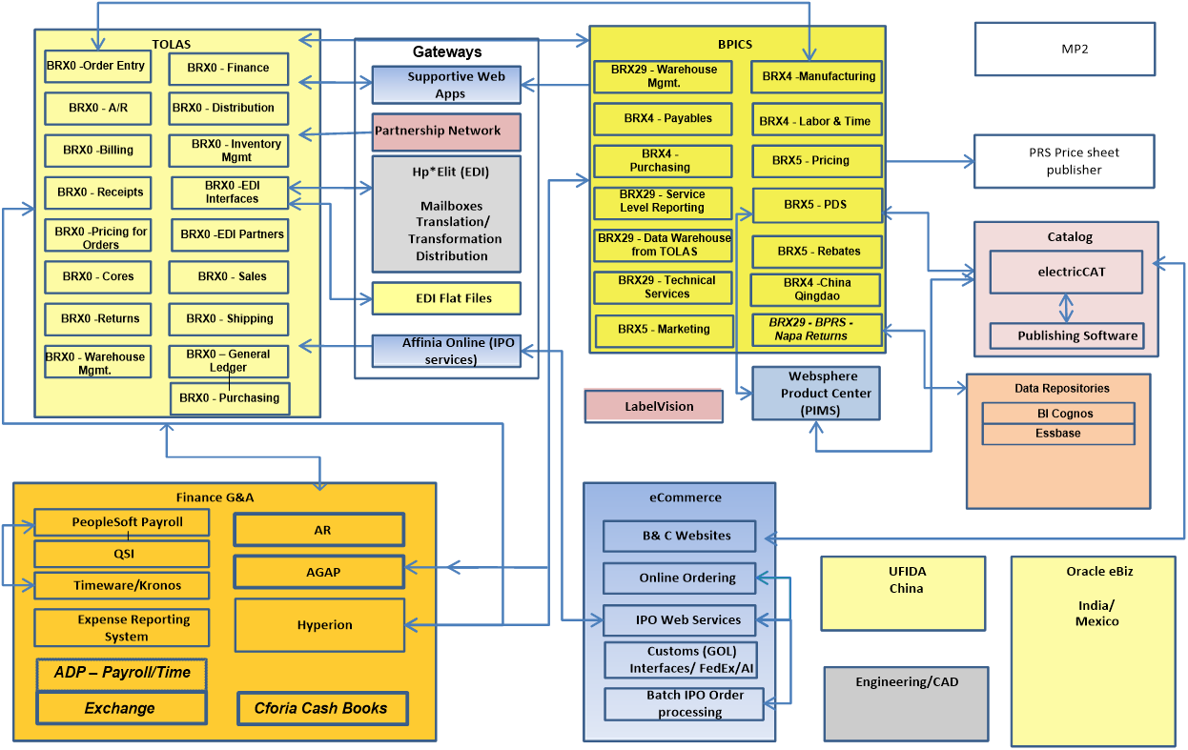
Legacy Application Footprint

Slide 8



Current Application Footprint

Slide 9
Working with End Users

Slide 10
Data, Data and More Data
31 Data Elements to be Converted
Multiple Source Systems with Redundant Data
No prior Data Governance in place
  Silo’s of data being merged
  Each facility had their own definition of data usage/fields
  3 sets of Items, BOMs, Routings
  Lack of corporate wide governance on data
Data Quality Issues
  Inconsistent use of data fields
  Inconsistent date formats w/in single data elements (mm/dd/yyyy & mm/dd/yy)
  Data Transformation rules different by Organization / Plant

Slide 11
Data Conversion Hits Critical Path Define, Divide & Conquer
Step 1: Defining the Effort
  Set Expectations on the overall effort
  Articulated the types of data cleanup issues
  Set Expectations on conversion duration
  Gained Executive commitment on resource assignments
    Executive Team
    Middle Management
    Business Community (Subject Matter Experts)
    End Users

Slide 12
Communicating the Size of the Effort
31 Data Sets
7 Systems of Record
  3 Silo Systems
  Redundant data everywhere
Timing of Data Extracts
  Master Data
  Transactional Data
Data Dependencies
  Data Cleanup
  Data Transformations
  Sequencing of Load
  Mid-conversion Processing
  Business Validations

Slide 13
Data Conversion Hits Critical Path
Define, Divide & Conquer
Step 2: Divide & Conquer
  Created 3 Separate Conversion Tracks
    Items
    Customers
    Suppliers
  Assigned PMO Leaders to Each Conversion Track
  Identified Conversion Team Members
    Business Owners (SMEs)
      Responsible for cleanup & validation
    Functional Owners (Implementation Leads)
      Works with Technical & Business teams to map &validate data
    Technical Owners (Legacy & Oracle)
      Responsible for writing & running conversion programs

Slide 14
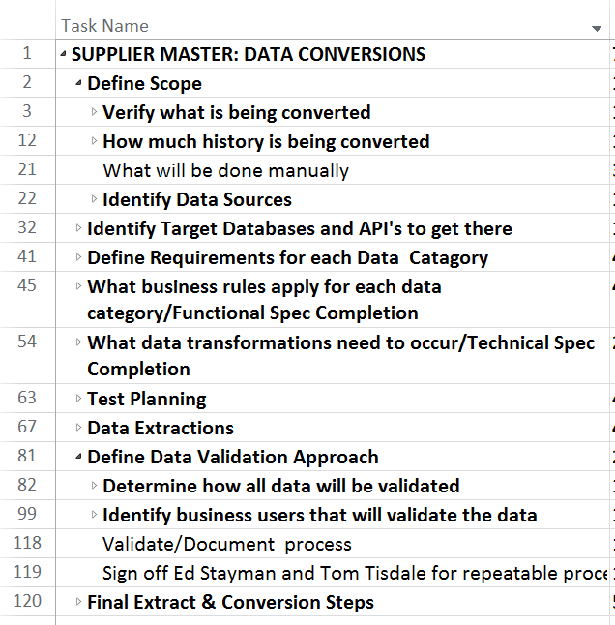
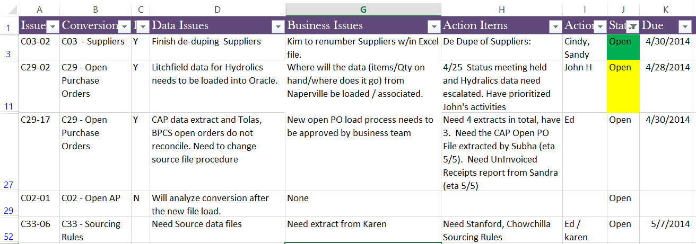
Managing Conversion Tracks
Created a Common Approach
  Standardized Tasks & Approach Across Teams
  Cleanup Needs Varied
Weekly Updates
  Track Team Meetings
  Cross Track Meetings

Slide 15
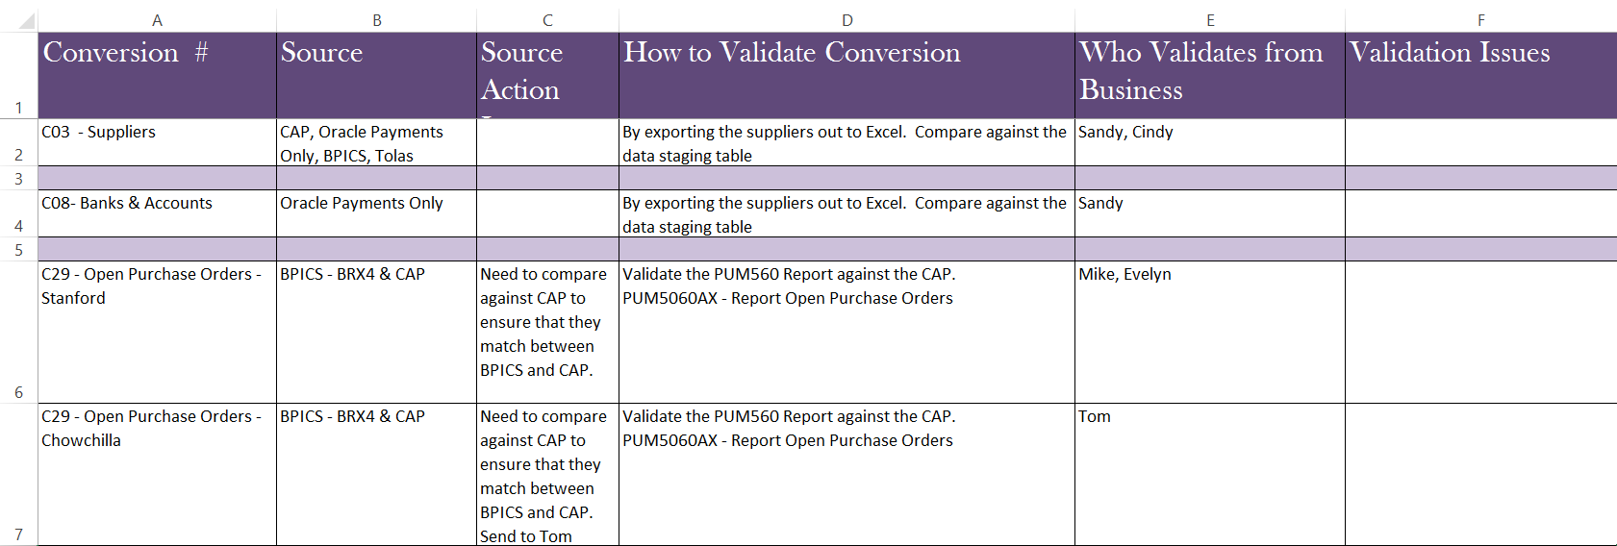
Data Validation Ownership
Appointed Business Owners for each Conversion Type
Defined Validation Steps
  Confirmed conversion data sources were complete
  Defined Validation processes for Extract & Conversion
  Tracked action items specific to each conversion

Slide 16
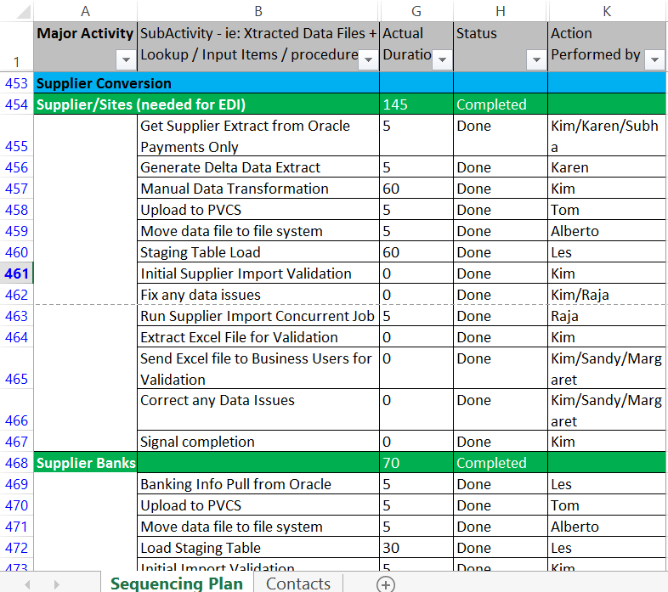
Practice Makes Perfect
UAT was a dry-run for production cut-over
  Integrated Business Owners through-out
  Validated each step of the conversion
  Captured timings
  Kept close status of:
    Data extract status
    Task dependencies
  Conversion Manager:
  Called task owners
  Central POC
  Reported status

Slide 17
End user tool evaluation for data loads
End users would participate in performing data loads
  Evaluated several solutions:
    Dataload, Interface, Excel based solutions
Requirements
Very little to no training required; easy to understand user interface
Can handle large amounts of data entry with error capture
Software support
Repetitive, could be used for post go-live activities
Answer: BPI decided on More4Apps

Slide 18
Spreadsheet World
If you can’t beat them, join them!
Purchased AR Receipts Wizard, BOM Wizard, Item Cost Wizard, Item Wizard [Includes Extension Wizard],AP Invoice Wizard, Price List Wizard, PO Wizard ,Sales Order Wizard, Upload Wizard, Routing Wizard, and Pricing Modifiers Wizard
Start with spreadsheet template and simplify
Add fields required by the business
Download More4Apps Template
IT work with end user to modify template and provide basic user training
IT test the new modified template (certify results)
IT hand over modified template to end users
End user populate templates with data, load in test environment for first time use (certify results)
End user load data in production
Notes:
Users feel comfortable using excel, don’t fight it…Work in the end-users comfort zone
BPI jumped in with both feet.

Slide 19
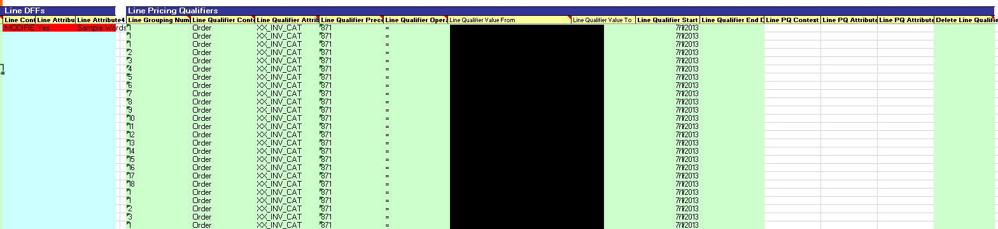
Pricing Modifiers
Needed to load more than 200 modifiers with more than 12,000 modifier lines
Start by understand pricing policies and requirements
Create matrix of pricing requirements to define pricing templates
Test each template and hand over to end users
End users continue to change pricing and continue to use solutions today

Slide 20
Item Load Process
Step # | Activity
1 | item and category definition in Master Org (More4Apps)
2 | assign items to orgs (More4Apps)
3 | define BOMs (More4Apps)
4 | define routings (More4Apps)
5 | load item costs (More4Apps)
6 | load item transaction defaults (More4Apps)
7 | load item primary pick locations (More4Apps)
8 | load caliper cross references for core returns (More4Apps)
9 | update planning attributes (More4Apps)
10 | load UOM intraclass for Pack (More4Apps)
11 | load customer item cross references (More4Apps)
12 | load OM item price list (More4Apps)
13 | load PO item pricing - BPAs (More4Apps)
14 | load ASL (manual)
15 | define sourcing rule (manual)
16 | load sourcing rule assignments (More4Apps)
17 | change item status (More4Apps)
BPI Item Setup involves various departments
Would take all week to setup in the system manually
Defined Item Definition Workbench
Process utilized to setup new Inventory Organization

Slide 21
Sales Order
Customer Service receives orders
  EDI, phone, fax, spreadsheet via email
Orders & Returns can have over 1,000 lines
  Entering an order manually was out of the question
Need a simple, repeatable solution
  Used More4Apps Upload Wizard
    3 fields: Order Number, Item Number, Quantity
Decrease entry time from 4 hours to 15 minutes
Enter Sales Order Header
Create Upload File
Select Actions> Add lines from spreadsheet
Book Order
Notes:
Multitude of ways for an order to make it to BPI,
If an EDI order misses it’s cutoff, Customer Service Rep will enter the order for the customer manually
Orders & Returns can have more than 1,000 would make it near impossible to accurately enter the order manually

Slide 22
Post Go-Live Manufacturing Sensei
Post Go Live, received above average tickets from Distribution and Manufacturing users
Identified tickets as business process and training challenges
Brought in Manufacturing “Sensei” with over 25 years of manufacturing experience and 15 years of Oracle IT
  Start with the top (build trust with stakeholders)
  Understand what they would really like to do and why
  Once he understands; provide options
Identified 3 areas of focus: Planning, Distribution, and Manufacturing

Slide 23
Post Go Live Findings
Challenges
Solutions
  Planning could not trust details in planners workbench
  Sales Orders unshipped in system but physically shipped out
  Released discrete jobs without inventory to perform product rework at distribution centers
  Modified inventory source setups, trained planners how to utilize workbench
  Corrected unshipped sales order lines; modified how reservations occurred moving forward
  Modified process to include component pick release, reduced backorder issues

Slide 24
Wrap-up

Slide 25
Lessons Learned
Training: Our experience showed that some groups were able to address the training needs of the end users very effectively, whereas, other groups needed help.
Data Conversion: Depending on the level of complication with the data, you should consider using industry standard ETL tools to help with data conversion.
Tools: Simple and effective wins the day.

Slide 26
Q&A
Rey Mendez
  Rey.mendez@elistarsolutions.com
  616.821.3339
Ed Stayman
  Ed.Stayman@brakepartsinc.com
  815.759.7822
Janet Dahmen
  Janet.Dahmen@avout.com
  630.962.4001

Slide 27
Please complete the session evaluation
We appreciate your feedback and insight
You may complete the session evaluation either on paper or online via the mobile app

